Slide 1
Technological capability and technological proximity in Thuringia 1990-2010
Present by: Group D
Mir Behroz Noor
Thanh Quyen Nguyen
Huyen Bui Thi

Slide 2
Table content
Motivation
The data
Thuringia technological capability and technological proximity 1990-2010
General views of Thuringia patents actitivities
Technological capability by sub-regions
Technological proximity by sub-regions

Slide 3
A. Motivation
Over the past decade, technological innovation is regarded as an important engine of economic growth. Technological capability could be considered as the resource which enables a firm to generate innovations in products, processes, and engineering projects and further discussed the accumulation path of technological capability. Therefore, technological capability plays an essential role in achieving rapid technological innovation. In this seminar, we pay attention to explore the technological capability and technology proximity at regional level of Thuringia over the period 1991-2010.
We would like to analyze more detail by divided this Thuringia data in to 4 areas and 4 periods which are the East, the North, the South and Center; 1990-1995, 1996-2000,2001-2005, 2006-2010 respectively. After this study, we would like to compare the technological capability and technology proximity between these areas over 4 periods mentioned above.

Slide 4
B. The Data
This study is based on regional-level data collected in OECD REGPAT and , EPO, OECD database.
OECD REGPAT and EPO patent quality data are linked by Applicant ID. Patent data can be regionalized on the basis of the address of either the inventor or the holder, with regions using NUTS3 code.
To address the questions of technological capability and proximity over time, we reply on these patent data in the period 1990 to 2010.
We add a new variable namely openness to external knowledge to study about the external knowledge flow to Thuringia. Based on the inventor share variable, we calculate the sum of inventor share of each patent; if the sum is smaller than 1, this patent has at least one inventor from other state.
After merging all the data with all variable needed, we divide Thuringia data in 4 sub-regions (east, north, south and central).

Slide 5
C. Thuringia technological capability and technological proximity 1990-2010
General views of Thuringia patent activities
Technological capability
Technological proximity

Slide 6
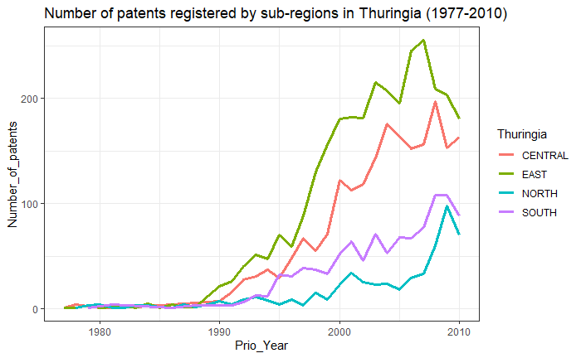
I. General views of Thuringia patents activities 1. The number of patents

Slide 7
I. General views of Thuringia patents activities 2. IPC3 class by sub-regions

Slide 8
II. Technological capability
Number of patents by sub-regions
Average scope of patent activities by sub-regions
Average forward citation of patents by sub-regions
Openness to External knowledge by sub-regions

Slide 9
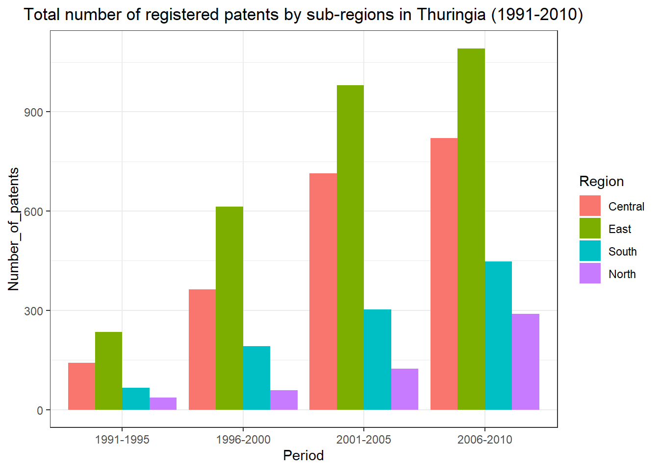
II. Technological capability 1. Number of patents by sub-regions

Slide 10
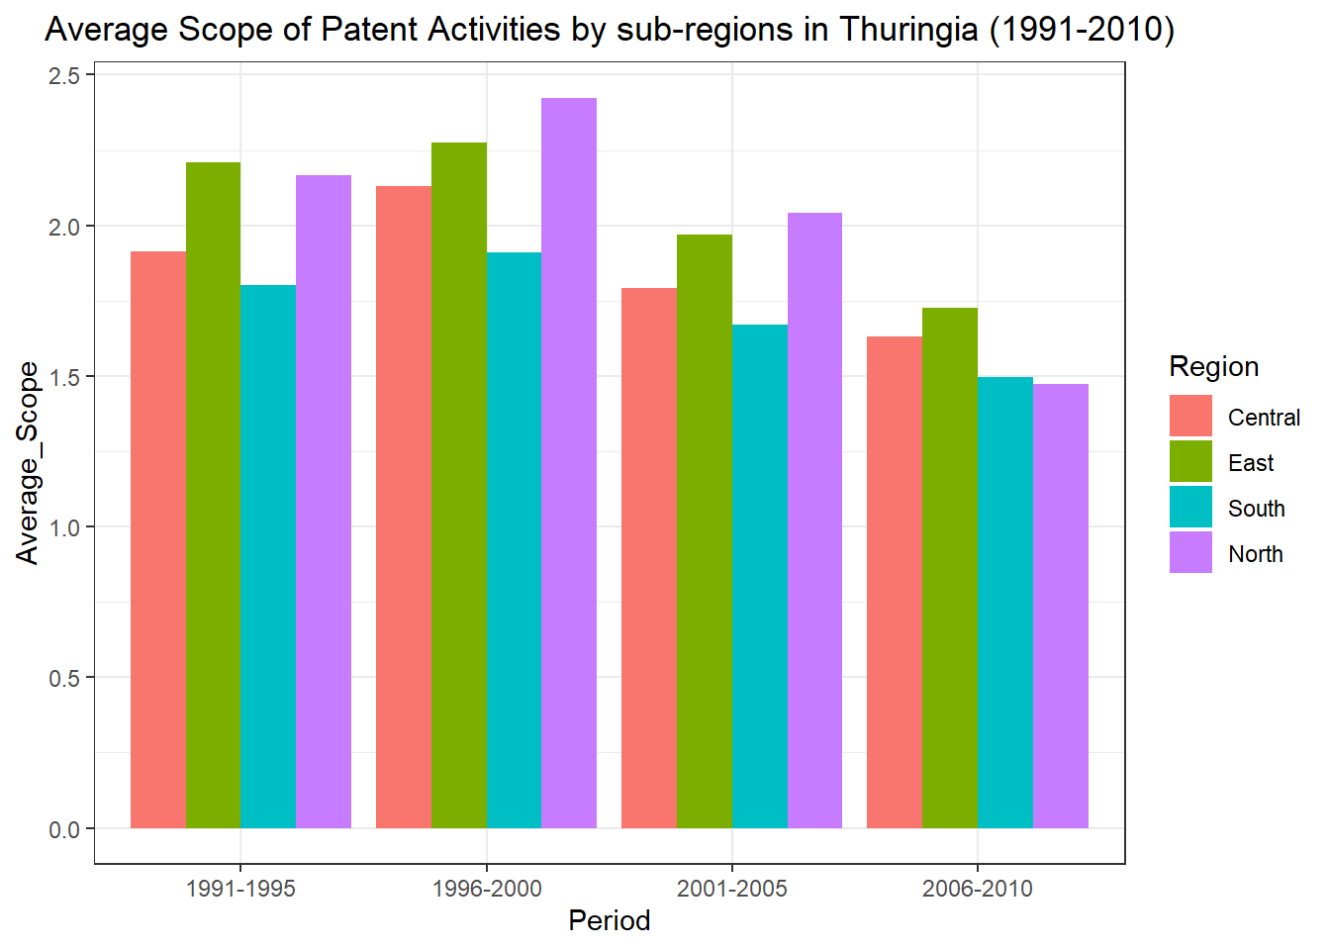
II. Technological capability 2. Average Scope of Patents by sub-regions

Slide 11
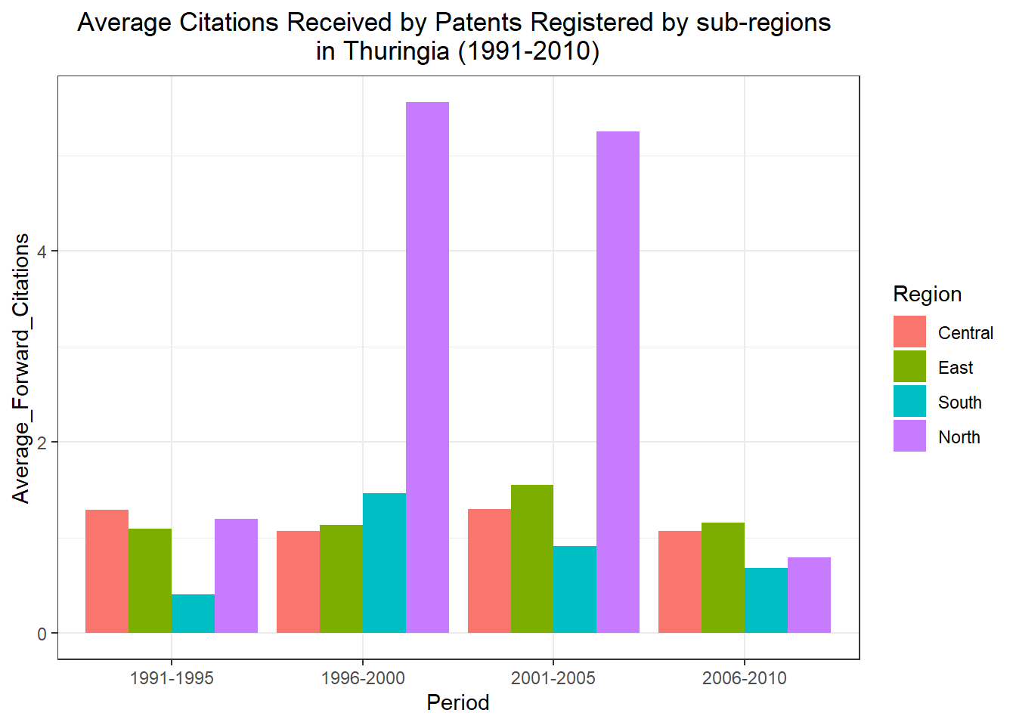
II. Technological capability 3. Average forward citation of patents by sub-regions

Slide 12
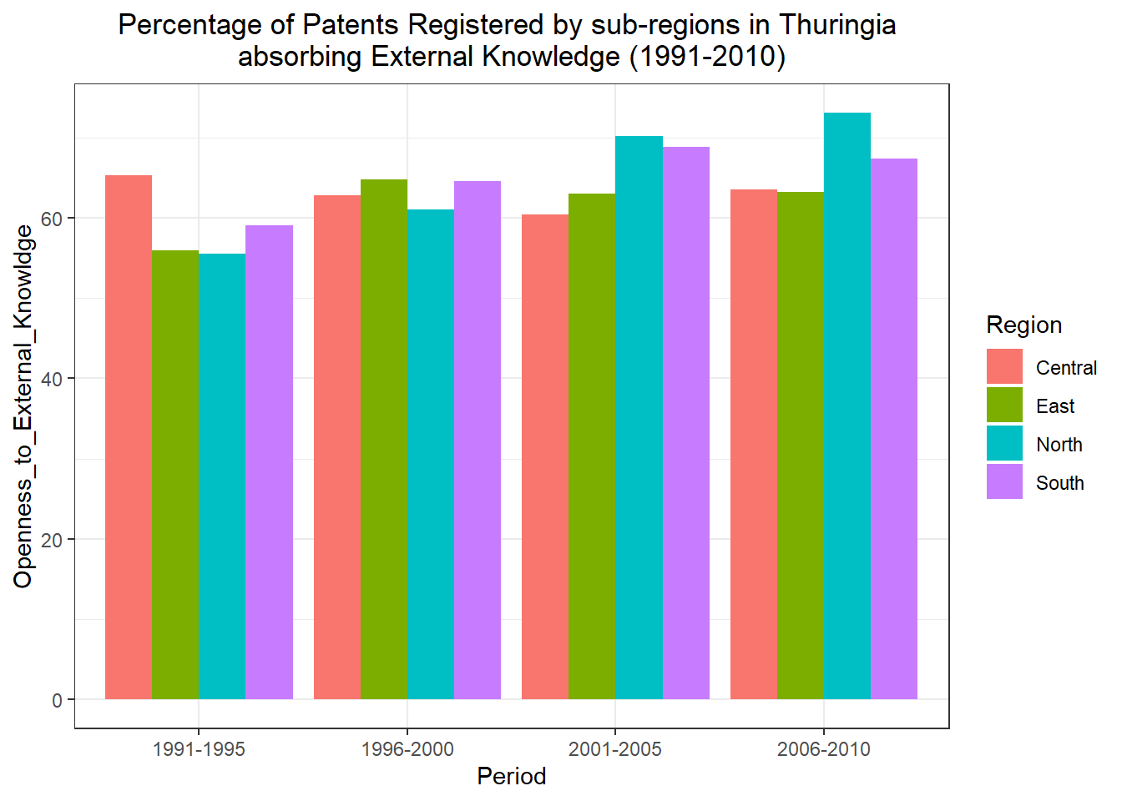
II. Technological capability 4. Openness to external knowledge by sub-regions

Slide 13

III. Technological proximity
Constructing technical proximity includes two steps.
Firstly, we build up a vector of 3-digit IPC classes shares for each sub-region.
After that, we calculate Euclidean distance (E) to compare two IPC classes shares vectors. Technological proximity between region i and j is defined as square root of sum of total square distance.

Slide 14
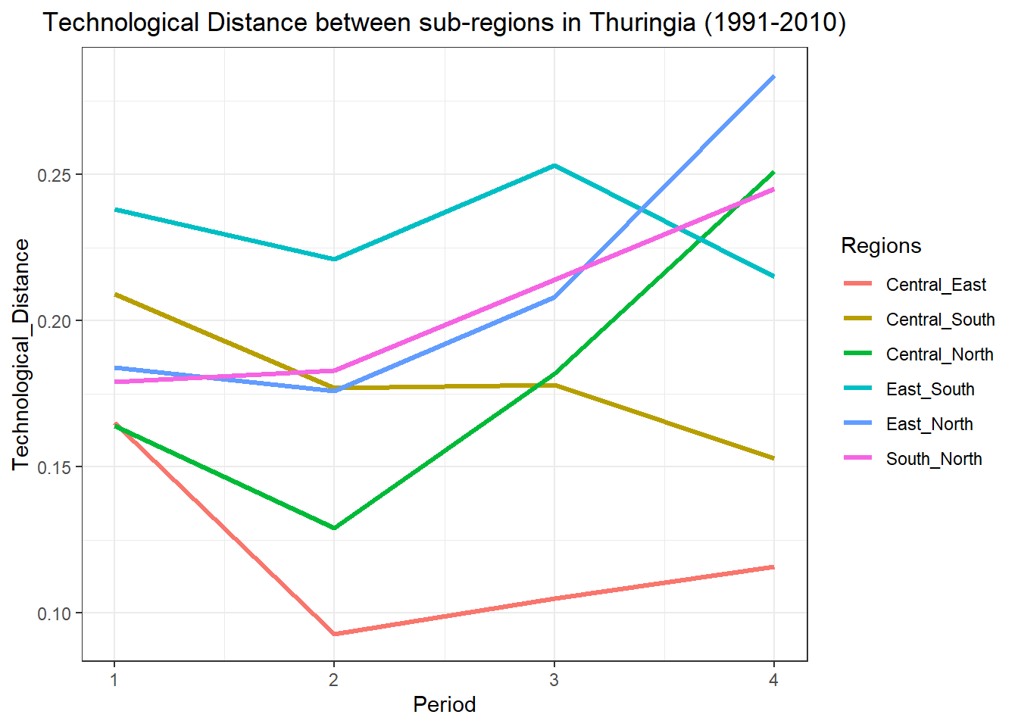
III. Technological proximity

Slide 15
D. Conclusion
The patent activities of Thuringia in 4 sub-regions witnessed an increase over the study period.
We propose that patent data is able to capture technological capability.
The more patents one has, the higher one’s technological capabilities. Regarding the number of patents, East and Central outperformed the other sub-regions
The number of the sectors under which the patent has been registered can also represent technological capabilities (patents scope). One average, patents registered by East and North Thuringia have broader scope than the rest of this state.
The number of citations a patent has received can be another measure of technological capabilities, namely the quality of the innovation. The average number of citations received by patents owned by sub-regions in Thuringia is too low, particularly, this measure is less than 2 for all regions during the period, except for North Thuringia
Finally, the ability to cooperate with inventors from outside regions also can be a measurement for technological capability. More than 55 percent of patents registered by sub-regions in Thuringia absorbed the external source of knowledge. The openness to external knowledge of North, South and East Thuringia increased while Central experienced a slight decrease.
Overall, while the technological distances between North and the rest part of Thuringia became more extensive, the knowledge domain of patenting activities of South, Central and East became more similar

